Slide 1
IBM HR Employee Attrition and Performance

Slide 2
Contents
Problem Statement
Data Sources and Tools Used
Solution Design
Exploratory Data Analysis
Models
Inferences

Slide 3
Problem statement
Business Problem :
To find the reason for attrition of employees.
Analytical Problem:
1. Find out the most prominent attributes that may be responsible for attrition.
2. Suggest the measures to bring down the current attrition rate and develop a model to predict the future attrition.

Slide 4
Data Sources and Tools Used
Data Source:
IBM Watson Analytics
Tools Used:
Exploratory Data Analysis: Excel, Tableau, Python, R, Weka
For Modelling and Programming: Python and R
For Visualization: Tableau and Python

Slide 5
Solution Design
Business Problem Understanding
Data Ingestion
Data Exploration (EDA)
Data Preparation (Transformation & Selection)
Classification & Model Building
Evaluation
Deployment

Slide 6
Data Dictionary
Data Dictionary
Attributes | Type | Values | Description
Age | Numerical | Numerical Values | contain the ages of different employees
Attrition | Categorical | Yes | contain the employees who are contributing to attrition
 |  | No | contain the employees who are not contributing to attrition
Business Travel | Categorical | Non-Travel | contain employees who have non travellig job profile
 |  | Travel_Frequently | contain employees who have frequent travelling job profile
 |  | Travel_Rarely | contain employees who have rare travelling job profile
DailyRate | Numerical | Numerical Values | contain the amount of money paid per day to an employee
Department | Categorical | Human Resources | contain employees who are in HR dept
 |  | Research & Development | contain employees who are in R&D dept
 |  | Sales | contain employees who are in Sales dept
DistanceFromHome | Numerical | Numerical Values | conain the distance between home and office wrt each employee
Education | Categorical | 1 | contain the employees who have Below College degree in their education qualification
 |  | 2 | contain the employees who have College degree in their education qualification
 |  | 3 | contain the employees who have Bachelor degree in their education qualification
 |  | 4 | contain the employees who have Master degree in their education qualification
 |  | 5 | contain the employees who have Doctor degree in their education qualification

Slide 7
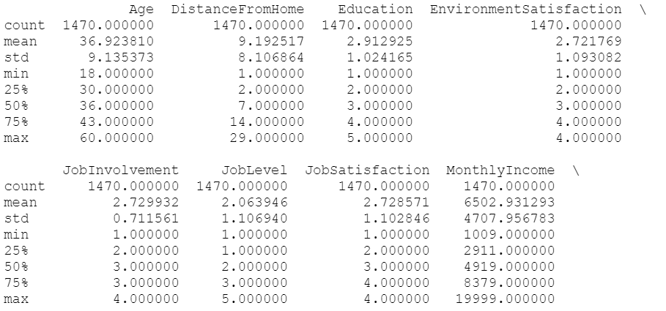
Descriptive Statistics

Slide 8
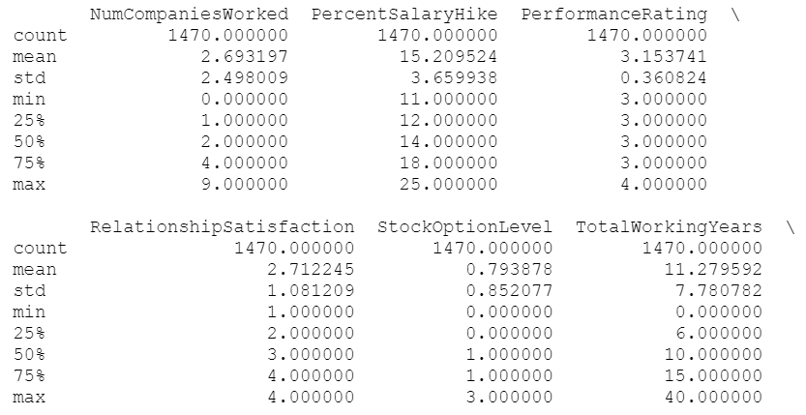
Descriptive Statistics

Slide 9
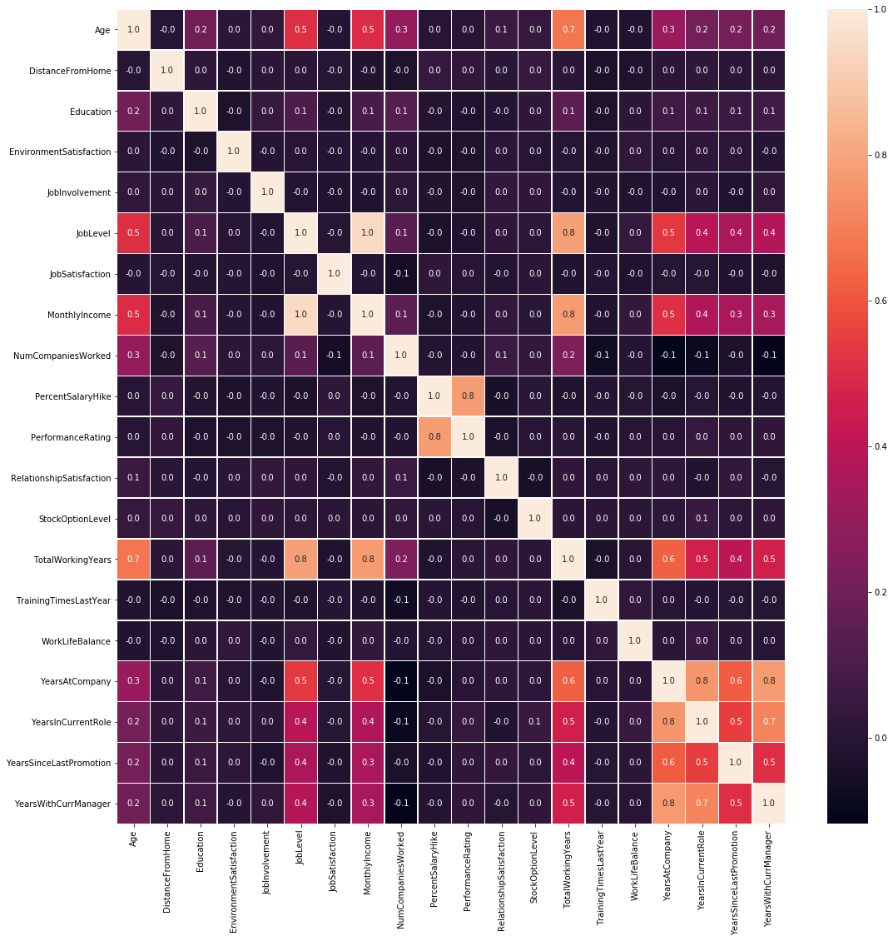
Collinearity verification

Slide 10
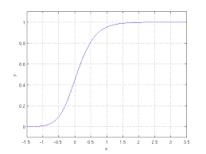
Modelling - Logistic Regression
Logistic regression is a statistical method for analyzing a dataset in which there are one or more independent variables that determine an outcome. The outcome is measured with a dichotomous variable (in which there are only two possible outcomes).

Slide 11
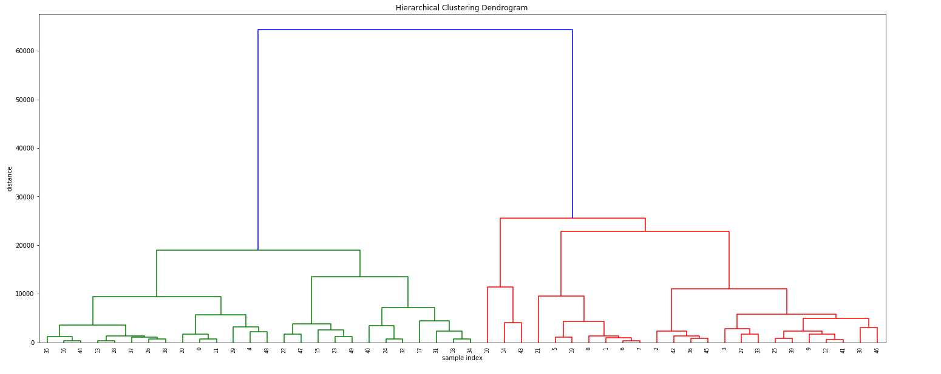
Cluster Analysis

Slide 12
Modelling - Random Forest
Random forests or random decision forests are an ensemble learning method for classification, regression and other tasks, that operate by constructing a multitude of decision trees at training time and outputting the class that is the mode of the classes (classification) or mean prediction (regression) of the individual trees. Random decision forests correct for decision trees' habit of overfitting to their training set.
Method used for creation of nodes - Gini Index
Ensemble machine learning algorithm - Bootstrap Aggregation or bagging
Library used in python for classification - scikit-learn an estimator
Library used for data exploration - NumPy, Matplotlib, Seaborn and Pandas

Slide 13
Inferences

Slide 14
Inference and Recommendation
Monthly Income is most prominent factor for attrition
Sales department has the highest percentage of attrition
Increase monthly income of sales department
Reduce overtime hours

